Slide 1

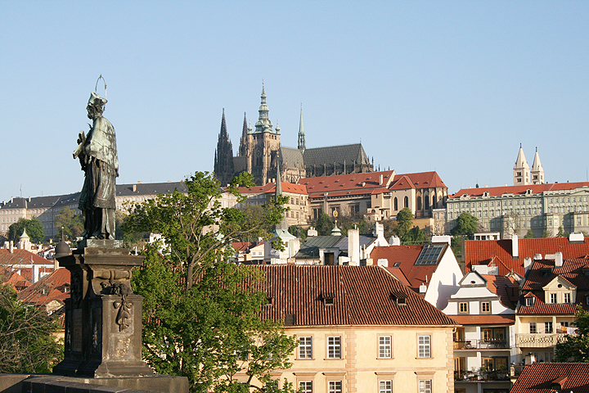



International Eye Bank of Prague
Ocular Tissue Bank OTB01 History, Present and Future
Member of International Federation of Eye & Tissue Banks, USA
Ophthalmology Department, Vinohrady Teaching Hospital
3rd Medical Faculty, Charles University,
Prague, Czech Republic

Slide 2

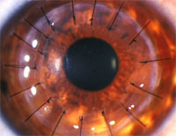

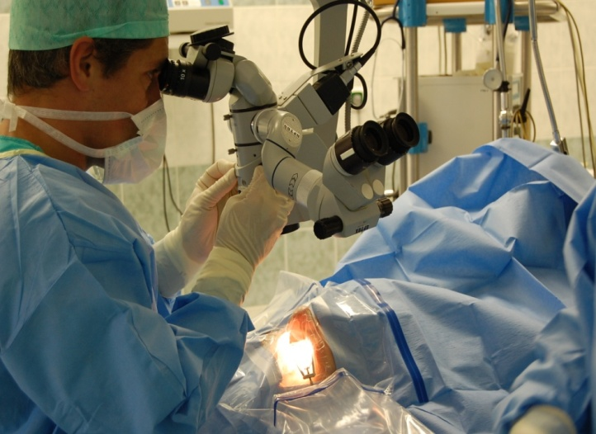
Ocular Tissue Bank OTB01/ International Eye Bank of Prague
Our Eye bank works also as a training centre for the International Federation of Eye and Tissue Banks.
The International Eye Bank of Prague was founded in November 1991 and was for many years the only Eye Bank in the Czech Republic.
Since its establishment in 1991 IEBP has greatly increased the collection of transplantable donor corneas and elevated eye banking performance standards as a leader in eye banking across Czech Republic.
Since foundation over 20.000 tissues were distributed.
Major changes occurred in past 5 years, due to new EU legislation and new type of product demands.

Slide 3
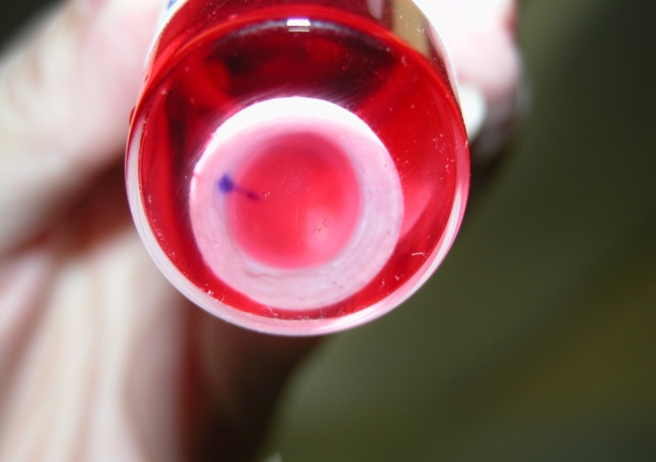
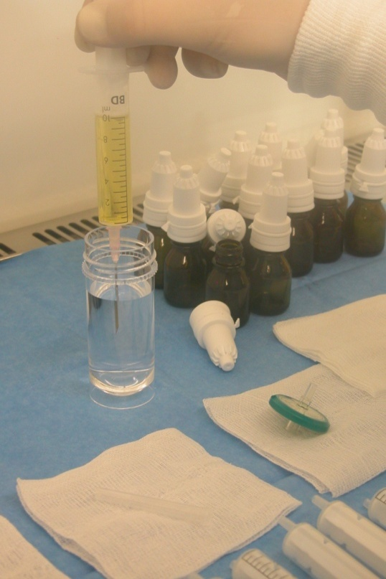
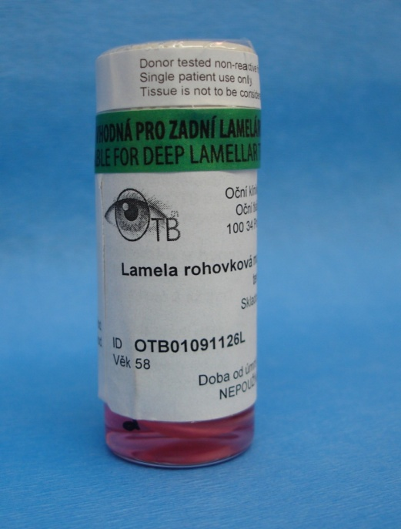
Type of tissues provides by IEBP
Human Corneas for PKP
Microkeratome prepared PreCut lamellae for DSAEK, DALK
Sclera fixed in etylalcohol
Autologous serum drops as a new product from 11/2011
Frozen amnions from 07/2013

Slide 4
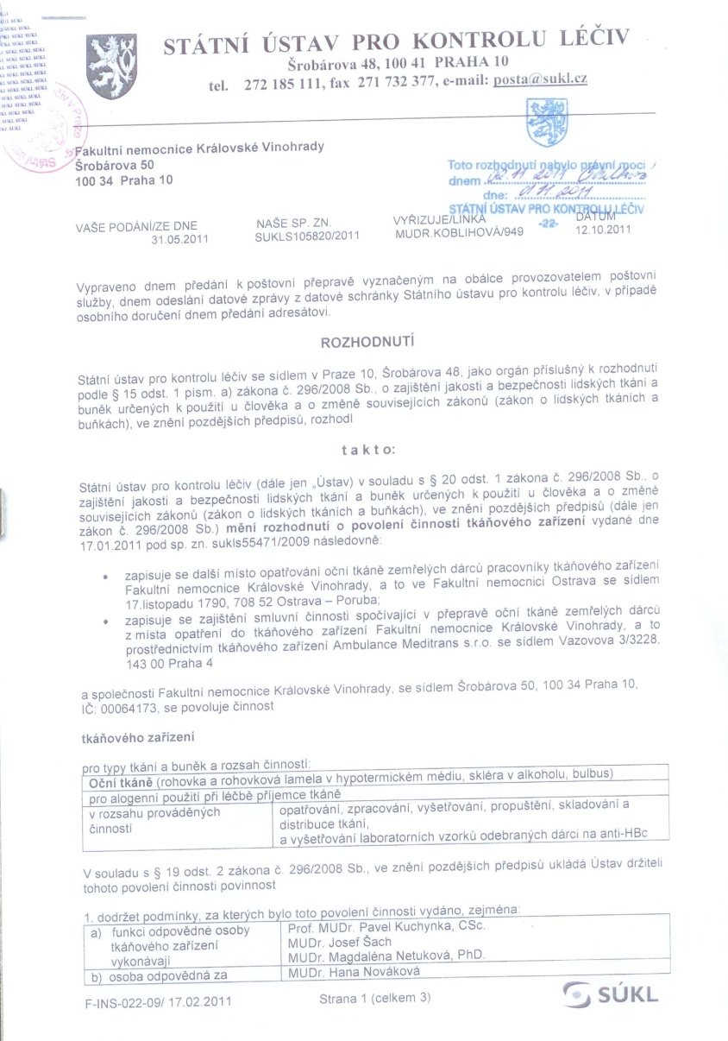

National Certification
State Institute for Drug Control
authorizing the activity of tissue establishment
THANK YOU FOR YOUR ATTENTION

Slide 5

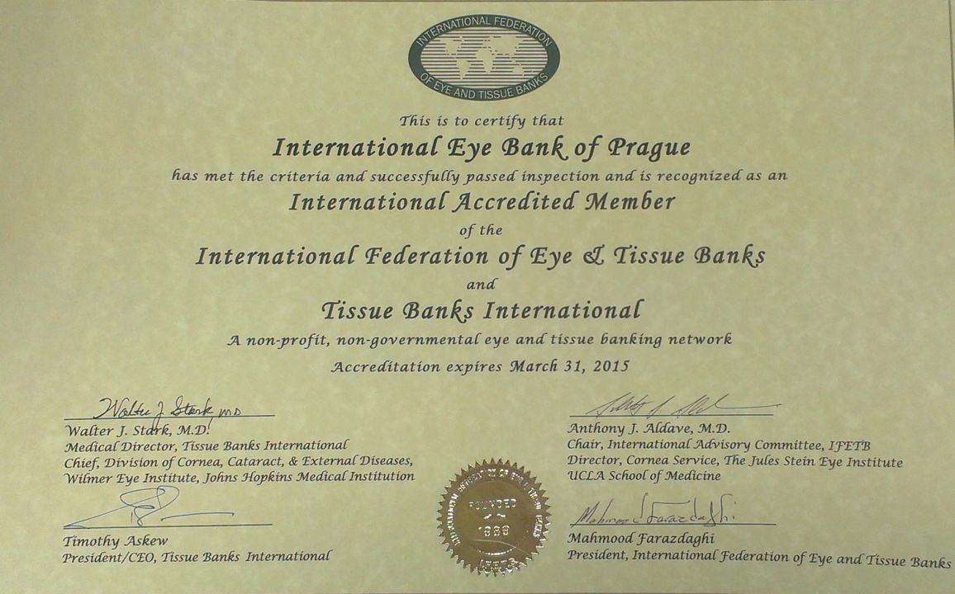
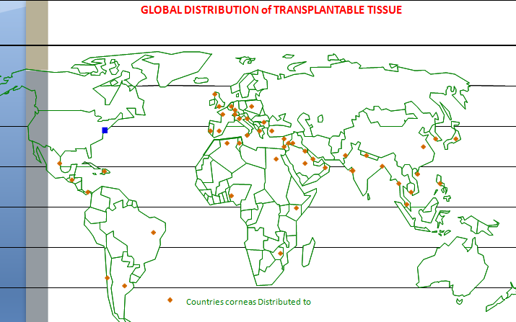
International Accreditation
Tissue Bank International, Baltimore, USA

Slide 6
Eye Bank Staff
Medical director
Medical supervisors - ophthalmologist and ocular pathologist
Eye bank manager
Eye Bank Technicians – all certified by TBI/IFETB
Prof. Pavel Kuchynka, MD, PhD.
Magdaléna Netuková, MD, PhD.
Josef Šach, MD
Vojtech Kolin, MD
Deli Siveková, MD, FEBO
Kateřina Liehneová, MD
Jan Hamouz, MD
Yveta Urbanova, MSc, CEBT
Jana Molova, CEBT
Ludmila Křivánková, CEBT
Jan Mládek, CEBT, CTBT
Ivana Vospálková, BSc., CEBT, CTBT
Jiřina Dušková, BSc., CEBT
Tereza Mojžíšová, CEBT, CTBT

Slide 7
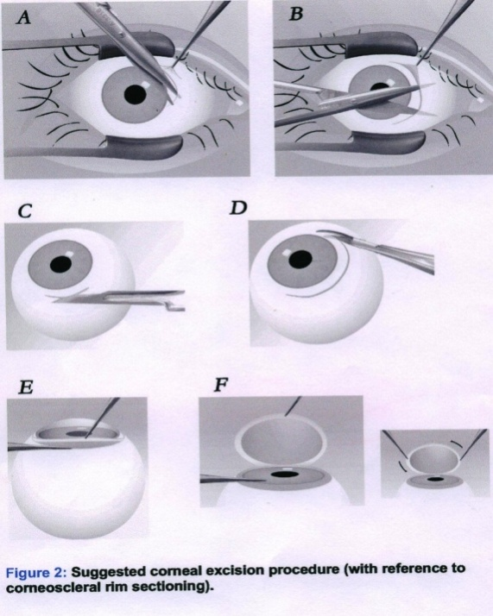
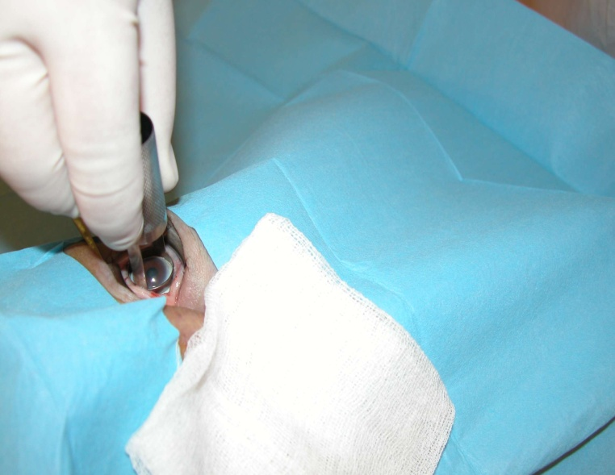
Method of cornea tissue retrieval
Corneoscleral excision, using Castroviejo Scissors and localy Designed Trephine

Slide 8
Educational Activities
1993 – TBI European Training Center in IEBP
1997 – Educational Visit for Prague Technicians to the TBI Center, Baltimore
IFETB Meetings
  Prague 1996
  Istanbul 2000
  IFETB Meeting - Bratislava 2003
  IFETB Managers Meeting 2005
EEBA Annual Meetings participations
  1995 - 2013
National, Regional Conference, Meetings
Lectures for medical students, nurses, ophthalmologists, surgeons, collecting centers, new locations

Slide 9
IFETB Training Center
Training center has comprehensive and structured training program for medical professionals to include medical directors, medical supervisors, pathologists, eye bank managers and technicians.
Program is comprised of intensive, customized courses, designed to fulfill the specific needs of participants
Depending on background and position of trainee, program extended from 1 up to 12 weeks.
Training center has trained more than 140 professionals around the globe.

Slide 10
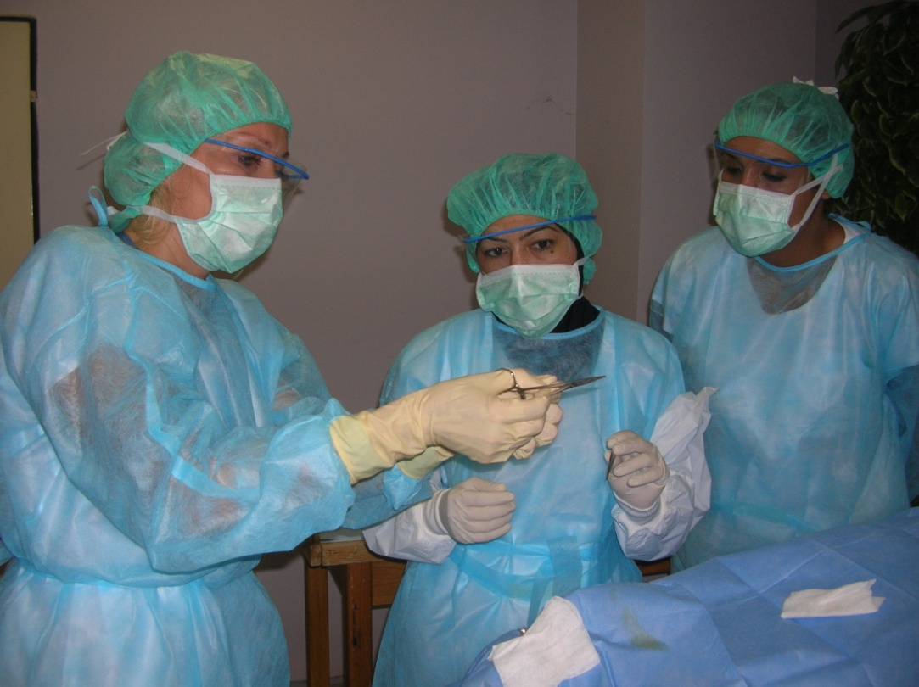
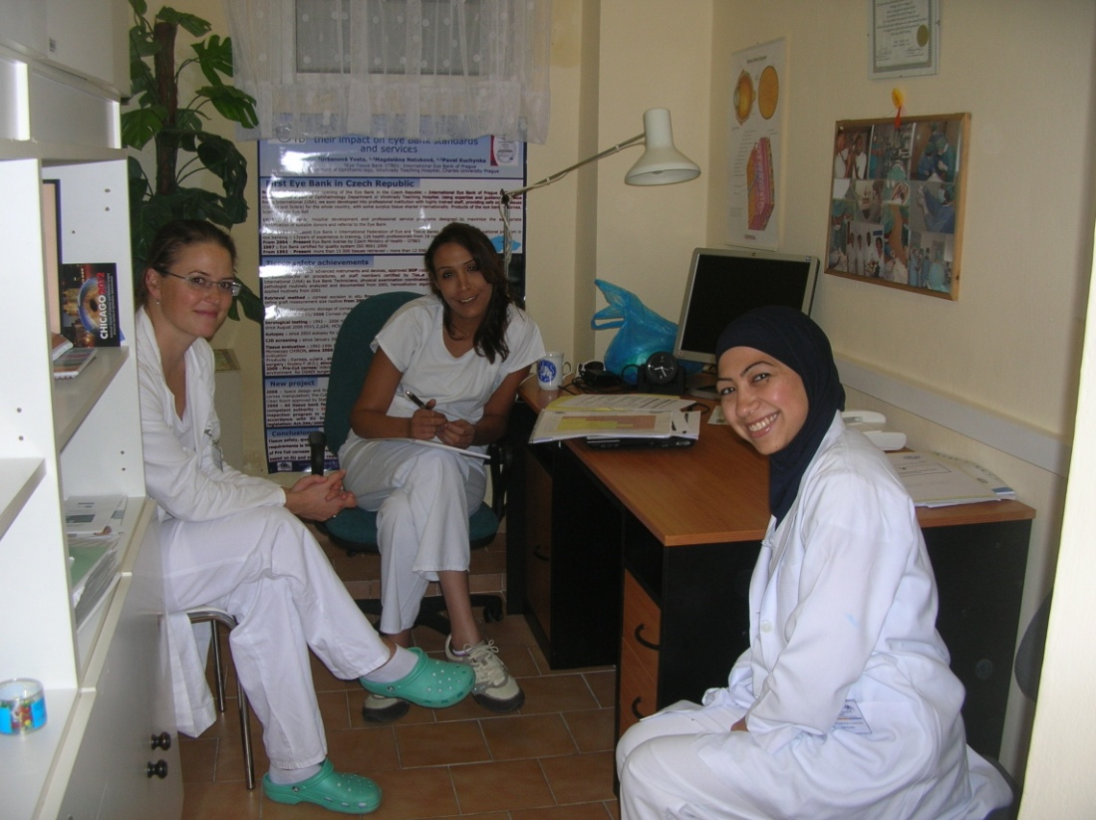
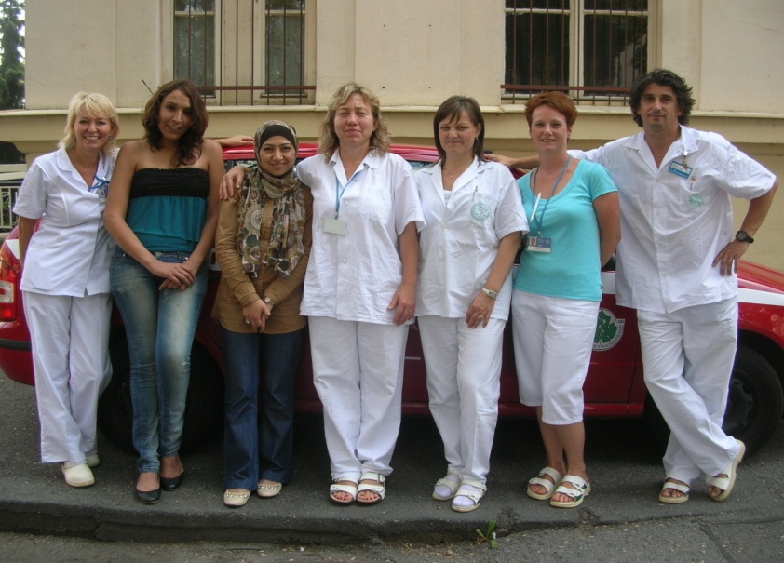
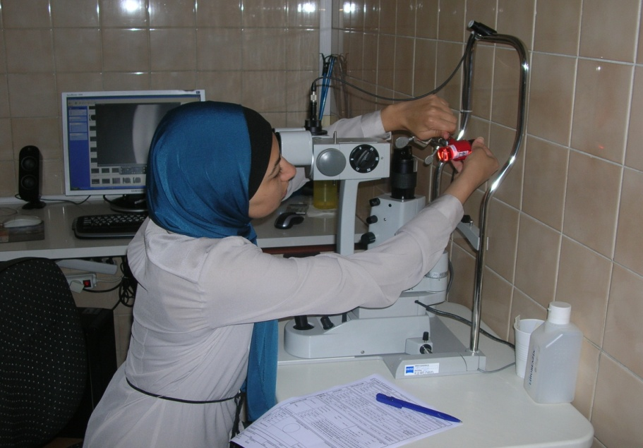
Training lectures, practical demontrations…..

Slide 11
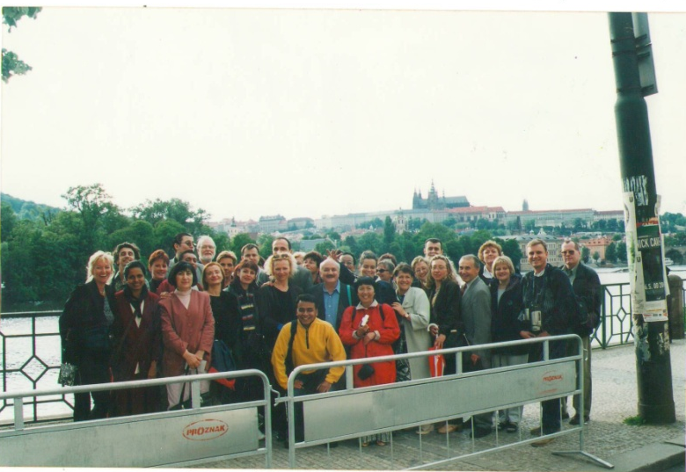
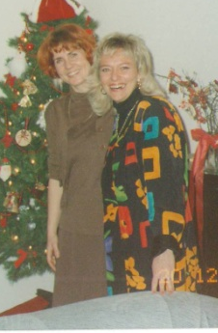
Some memories with friends……
Prague Conference
2001
Prague Training
1995

Slide 12

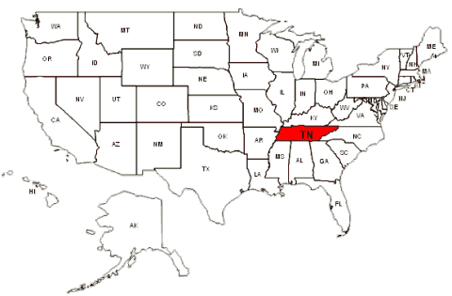
Training for Pre Cut Program, TBI, NEBC, Memphis
TBI established 1962
National Eye Bank Center 2005
Process, store and distribute eye tissue, collected from 20US Eye Banks
Cornea, Pre- Cut for DMEK, DSAEK
Sterile cornea- irradiated cornea allograft
Supplies tissues to 220 surgeons across United States
Process app. 500 – 600 tissue/month
  MORIA microkeratome preparation
  Femtosecond Laser Cornea preparation
Memphis
NEBC

Slide 13
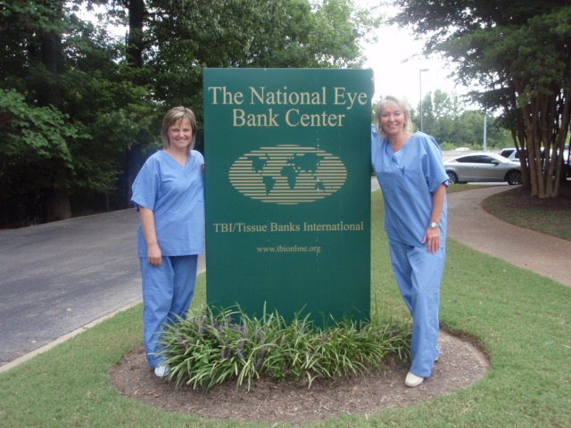
Pre Cut Training 2009

Slide 14
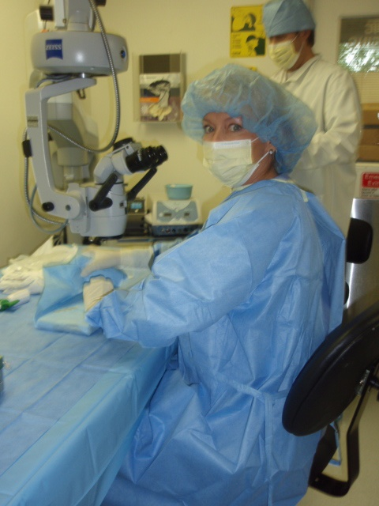
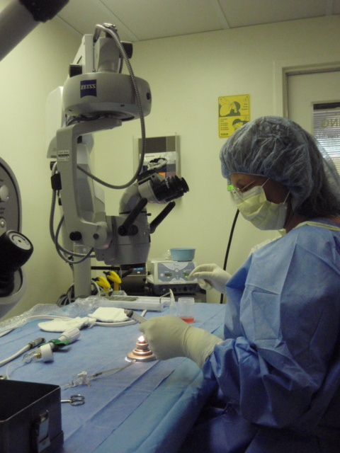
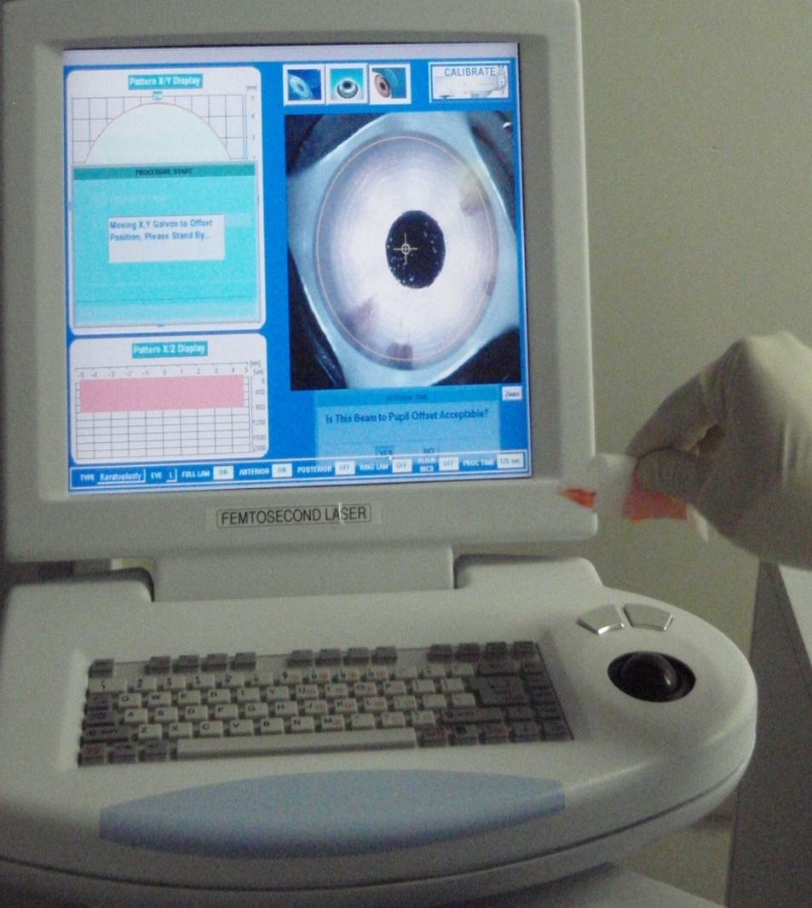
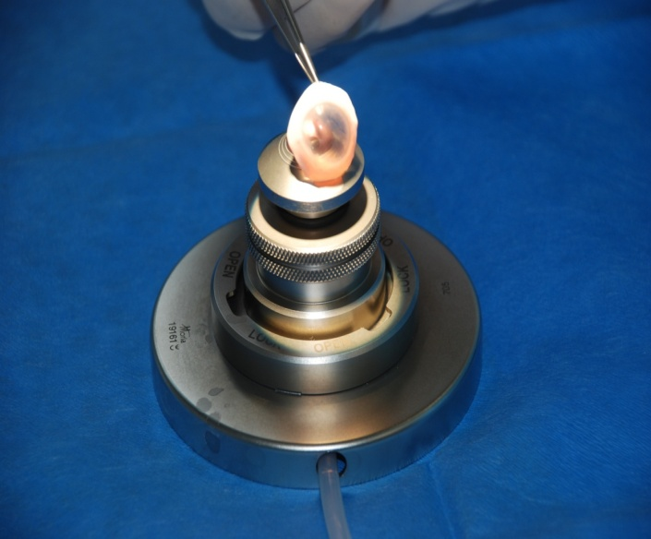
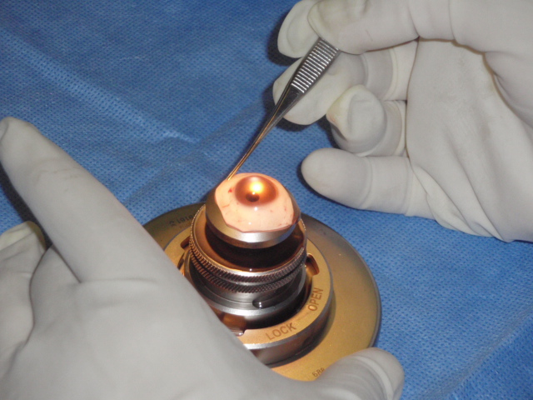
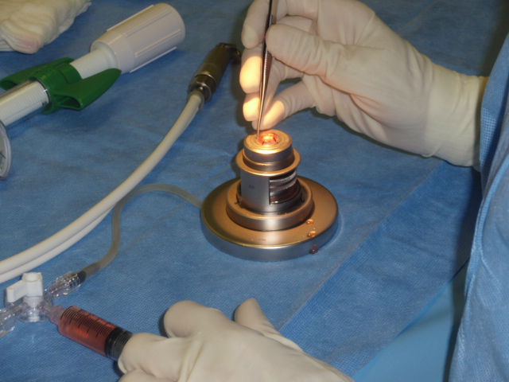

Slide 15
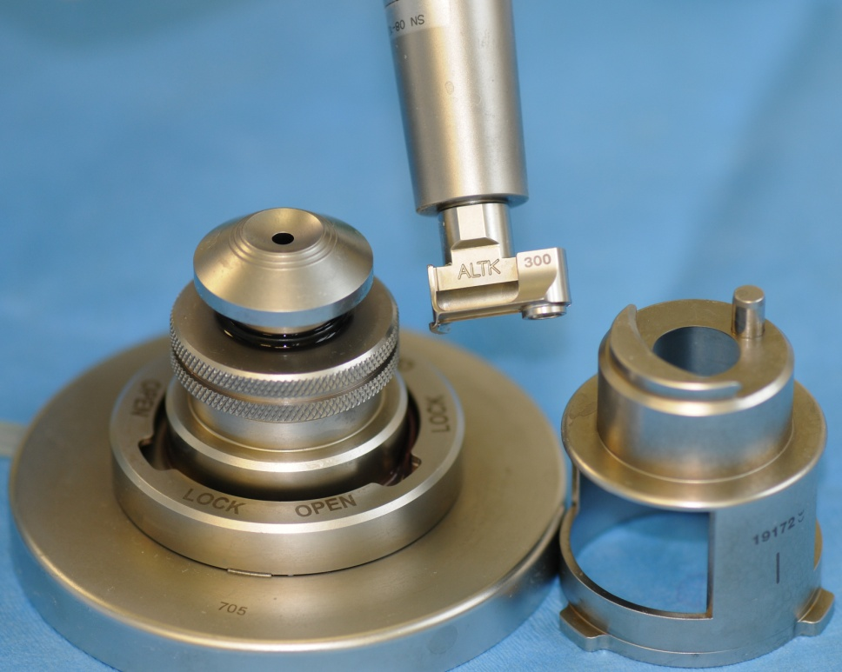
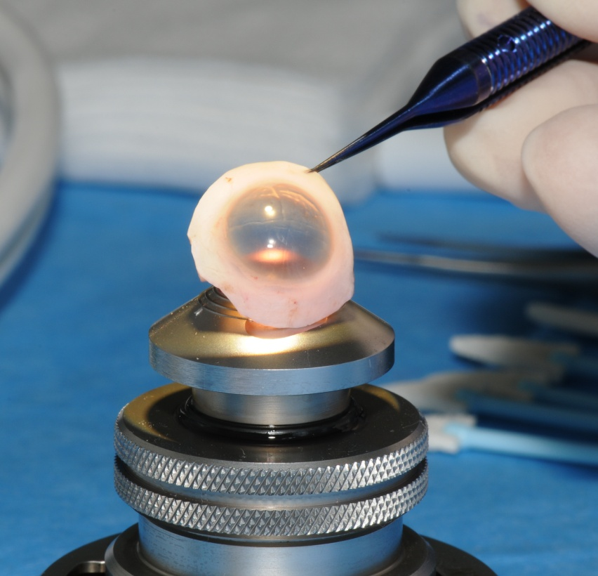
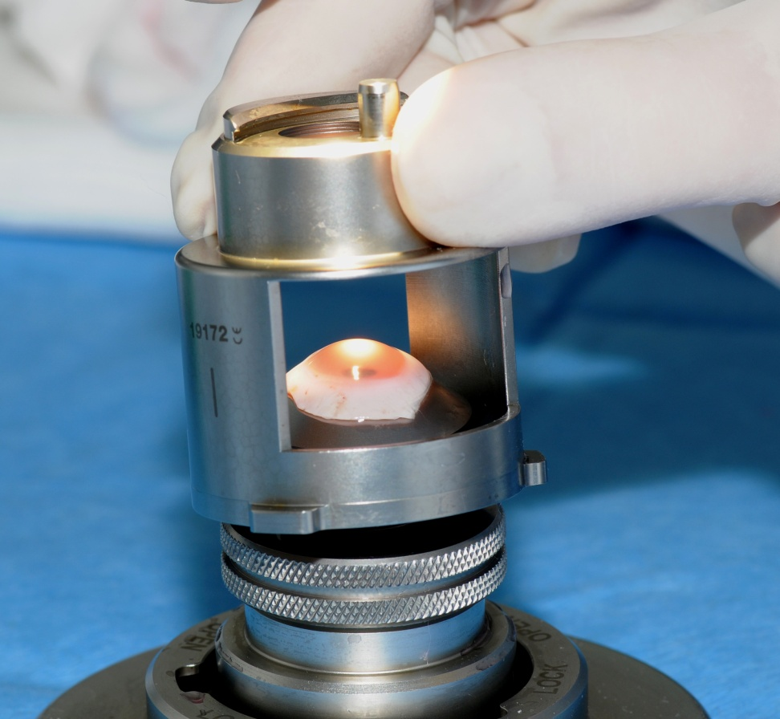
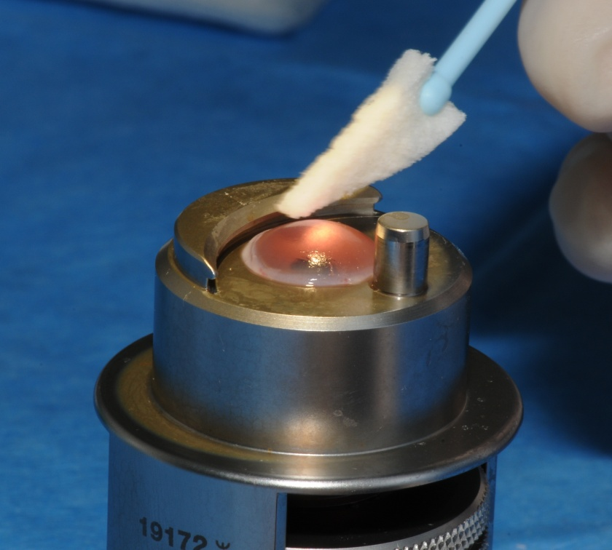
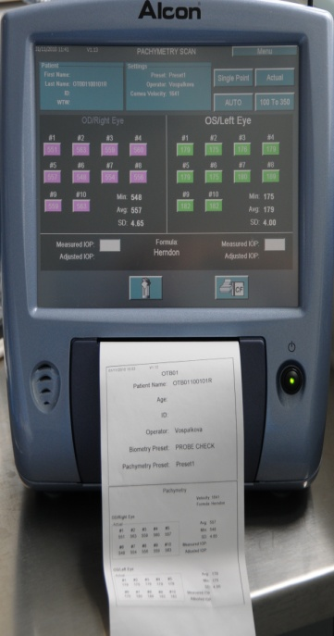
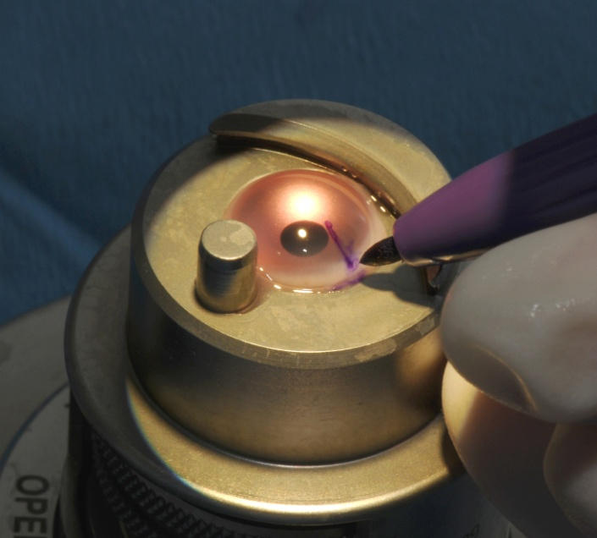
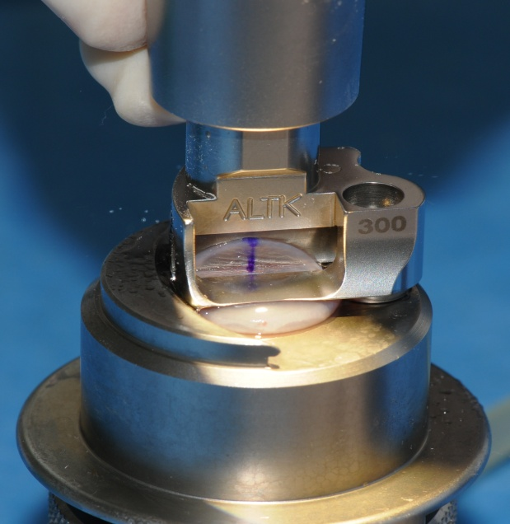
Processing tissues for DSAEK – MORIA microkeratome

Slide 16
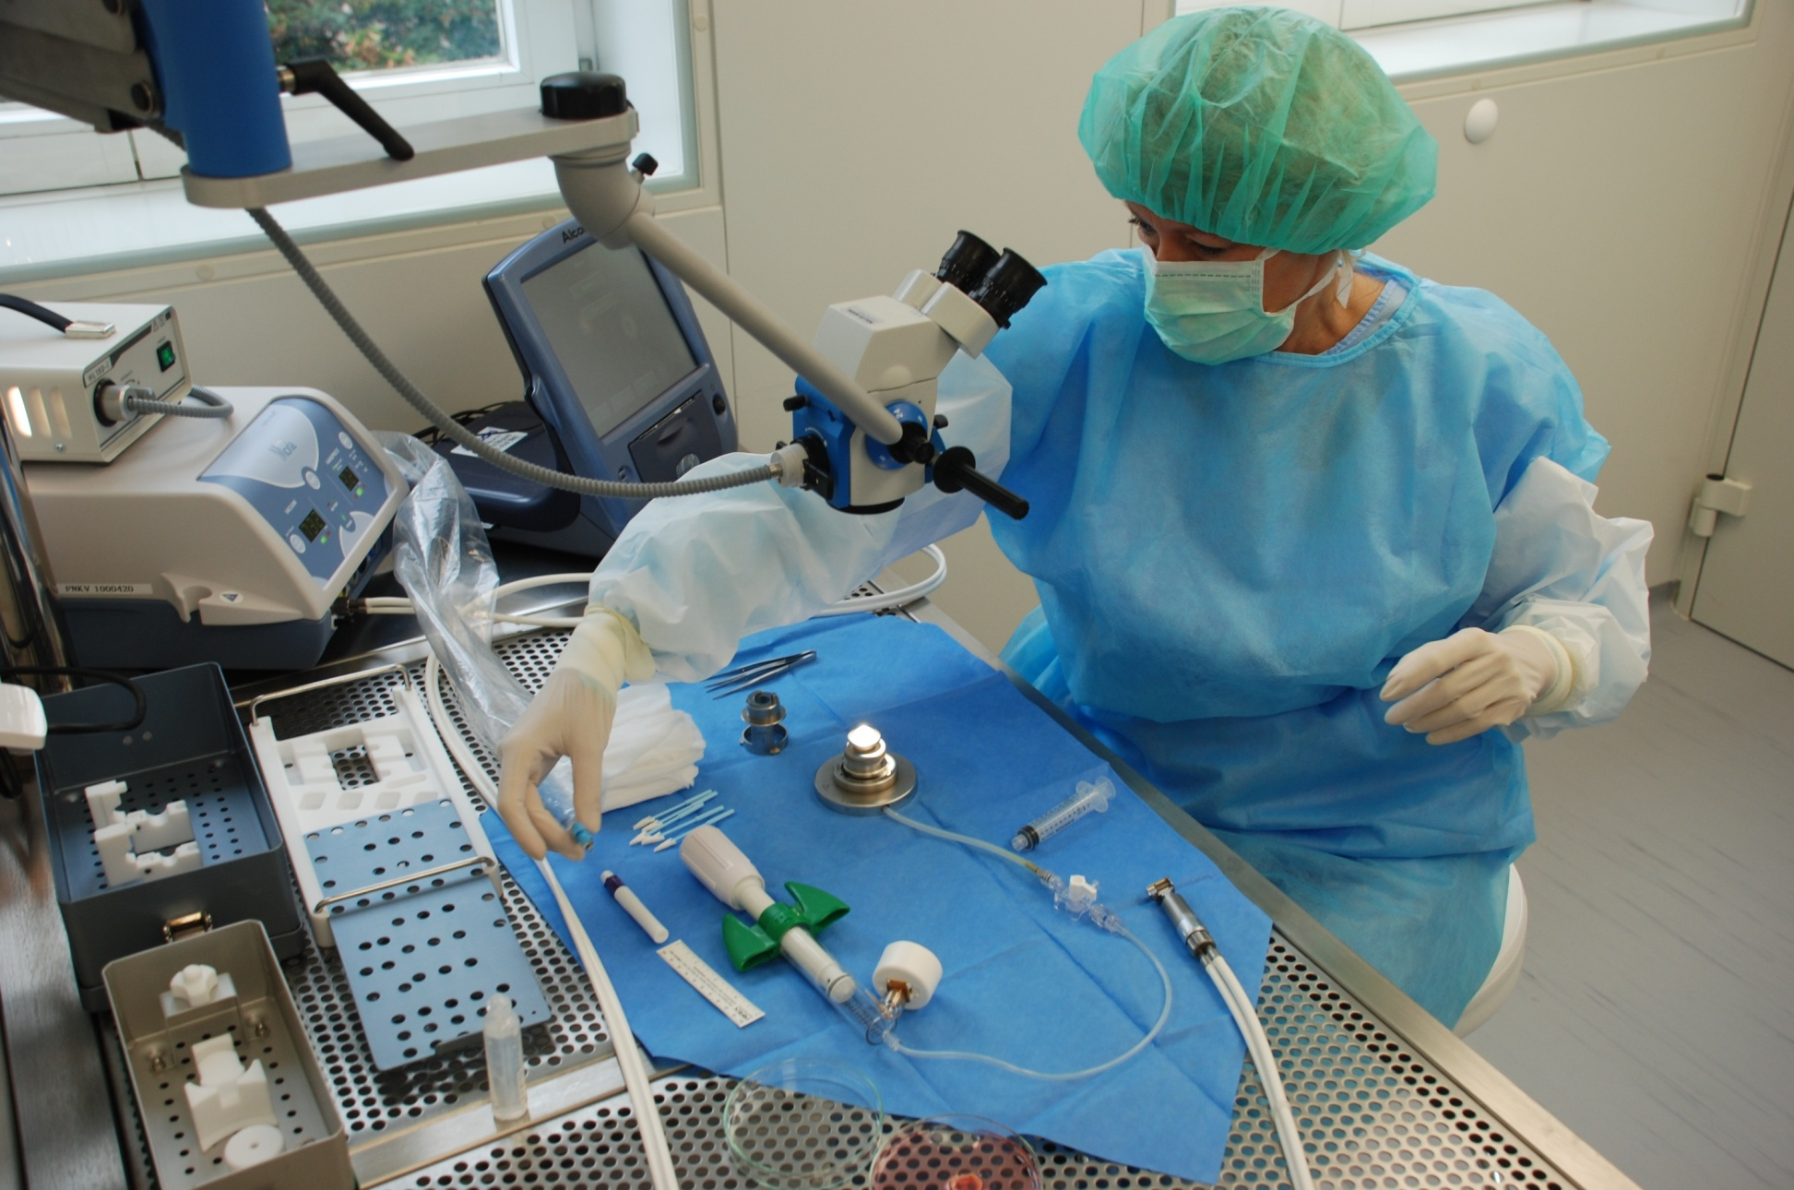
Preparation in Clean Room - GMP Grade A air quality

Slide 17
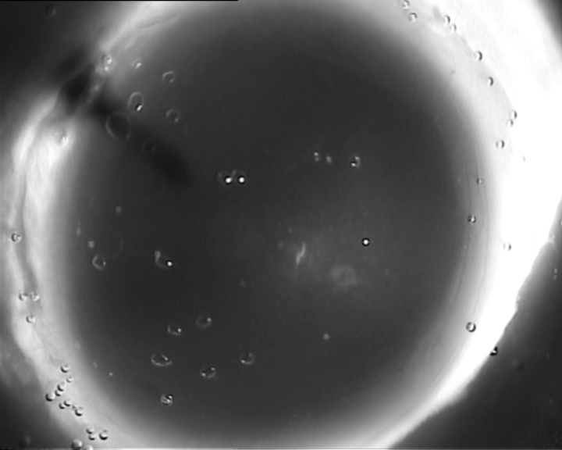

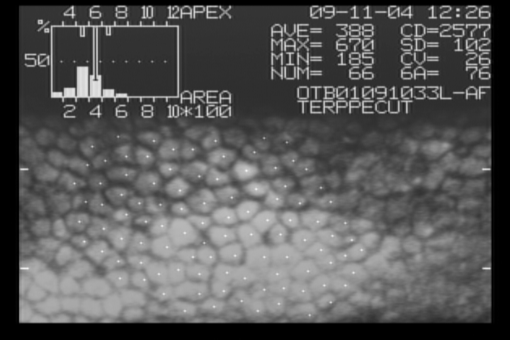

Pre Cut Tissue for Lamellar Keratoplasty

Slide 18


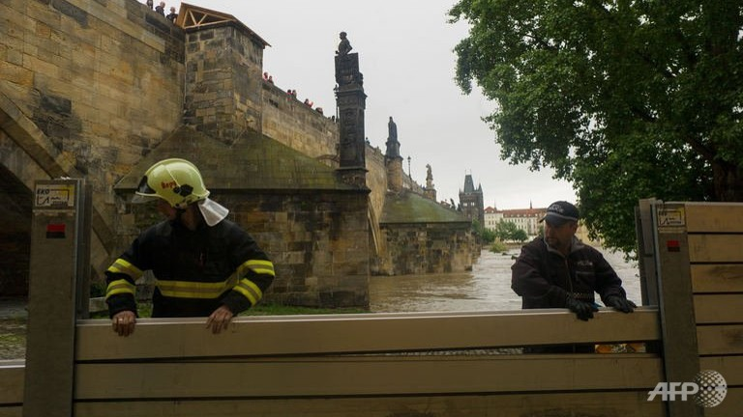
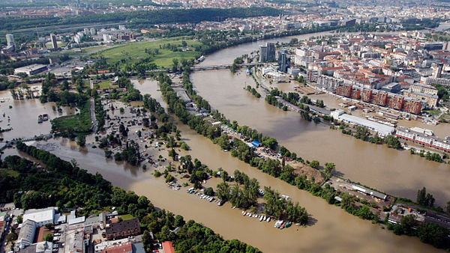







Co chcete sdělit?

Slide 19
Thank you for your invitation

