Slide 1

Polski Bank Komórek Macierzystych S.A.
(FamiCord Group)
June 2013
version: 1.9. eng.

Slide 2
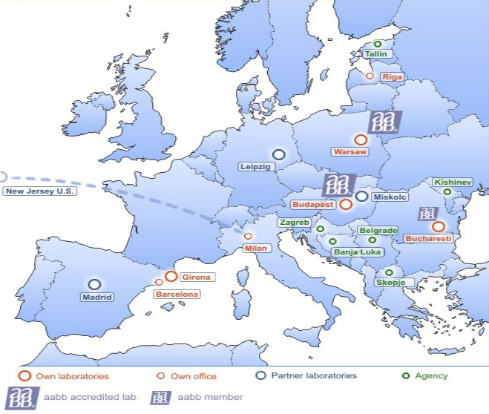


FamiCord Group profile
Presence in Europe
International scope
3rd largest European private cord blood bank
Operates in 20 countries in Europe
9 offices (3 in Poland, 2 in Hungary, Spain, Italy, Romania, Latvia), 30+ lab technicians, 10 medical doctors
7 own laboratories (3 in Poland, Spain, Hungary, 2 in Romania) and 4 partner laboratories (Hungary, USA, 2 in Germany)
Partner network in Serbia, Croatia, Moldova, Estonia, Macedonia, Bosnia and Hercegowina
High quality service
AABB Accreditation (American Association of Blood Banks),
ISO 9001:2008 Certificate,
ISO 14001:2004 Certificate,
IATA PI650 Certificate
2

Slide 3

FamiCord Group European data
Cord blood stored at PBKM (the Polish Stem Cell Bank) released for transplantation first time in 2007
Until now 13 cord blood units released for transplantations from performed, 10 in Poland, 3 in Hungary
70,000 cord blood units for family use
2,300~ cord blood units for public use
25,000+ samples of human semen
5,000+ units of cord tissue
500+ samples of DNA
1

Slide 4
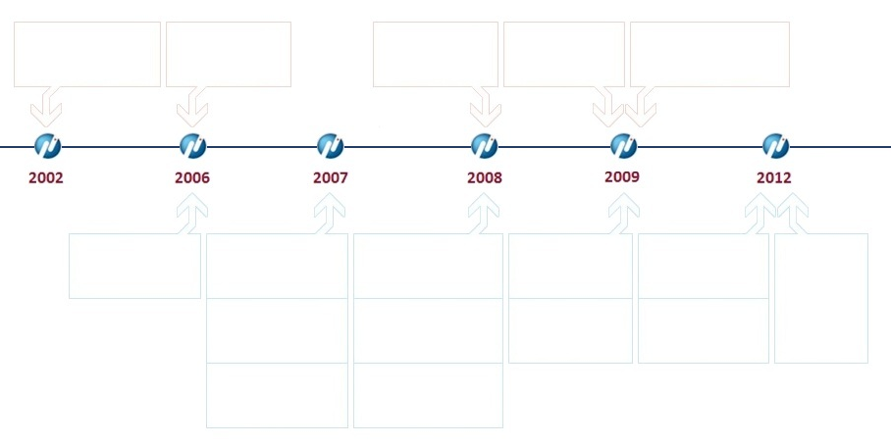
Corporate milestones
Equity investments and international development /more than PLN 20mln invested/
Company established by 5 persons
Entry of Business Angel
Entry of a group of investors I
Entry of a group of investors II
Entry of Enterprise Investors Venture Fund
2013
Small acquisition of 3,5% at Vidacord (Spain)
Acquisition of 100% of Cilmes Sunu Banka (Latvia)
Joint-venture of 25% at Sevibe Cells (Spain)
Investment of 100% at Famicord Italia (Italy)
Increase to 56% of Sevibe Cells (Spain)
2013 – take-over of part of business activity from Freezlife (Romania)
Two transactions to be closed in H1 2013
Acquisition of 74,5% of Krio Institute (Hungary)
Increase to 96,5% of Krio Institute (Hungary)
Increase to 66% of Biogenis (Romania)
Take-over of 52% of Fotomilla Zrt (Hungary)
Joint-venture of 50% at Biogenis (Romania)
Take-over of part of business activity from Activistion Life (Poland)

Slide 5

Member companies: Poland part 1
The largest private cord blood bank in Poland with ~75% of market share
The largest public cord blood bank in Poland
2nd bank & laboratory in Europe accredited by AABB
Service avaliable also in Germany, UK, Ireland
3

Slide 6
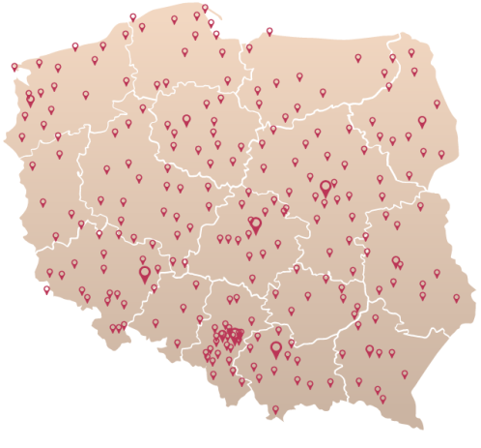
Member companies: Poland part 2
In Poland:
Broad operating range
Professional medical consultations available through the whole country
Cooperation agreement with all the hospitals in Poland
3 laboratories (1 working, 2 to be opened in a few weeks)
80+ people, 15 at the laboratory, 4 medical doctors
Around 400 agreements with hospitals
More than 3000 agreements with cooperating medical staff
Cooperation with a couple of universities, clinics and Polish Academy of Science
3

Slide 7


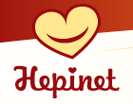
Member companies: CEE
In Hungary:
In Romania:
Krio Institute ZRt.
The largest cord blood bank in Hungary
One of the oldest (1998) bank of human semen in Eastern Europe and the largest one in Hungary (out of 4)
45%+ marketshare
Controlled in 95,5% by the FamiCord Group
Own laboratory located in Budapest
3 sucessful transplantations
www.krio.hu
Biogenis S.C.
2nd largest cord blood bank in Romania (out of over 20)
Controlled 66% by the FamiCord Group
Own laboratory located in Bucharest
www.biogenis.ro
STEM LAB
Specialized diagnostic lab
Hepinet
USG network
www.hepinet.hu
4

Slide 8



Member companies: Other
In Spain:
In Italy:
In Latvia:
Sevibe Cells S.L.
Established in 2008
2nd largest cord blood bank in Spain (out of over 15)
Controlled 56% by FamiCord Group
Own laboratory in Girona
www.sevibe.es
Famicord Italia
Established in 2009
Small player in Italy (out of over 20)
Fully controlled by FamiCord Group
Cooperate with Famicord laboratory in Poland and partner laboratory in New Jersey in USA
Cilmes Sunu Banka SIA
Established in 2004
The largest cord blood bank in Latvia
Fully controlled by FamiCord Group
Cooperate with Famicord laborartory in Warsaw
www.nabassaite.lv
5

Slide 9
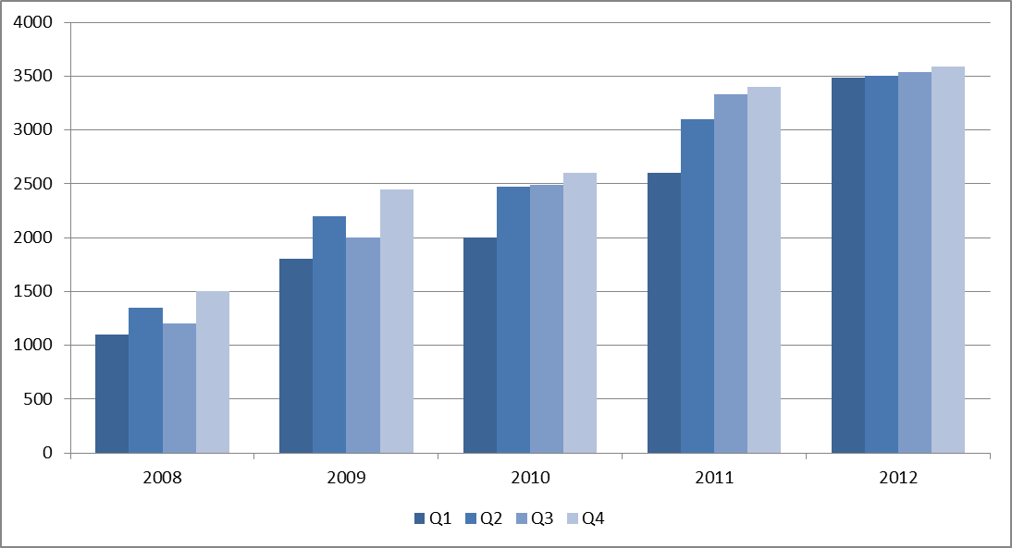
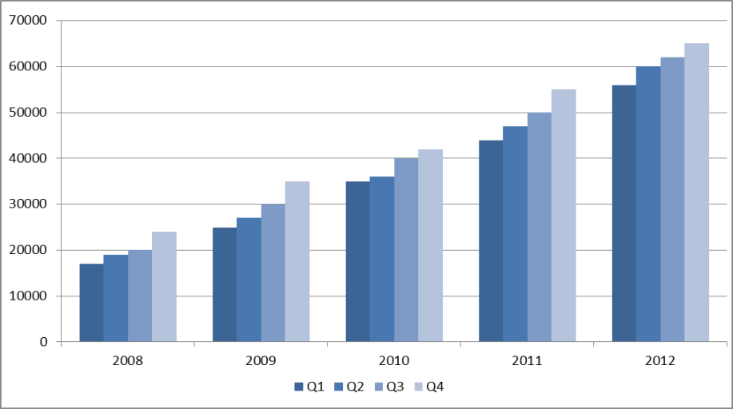
Consistent growth of subscribers
New agreements signed
Total subscribed units stored
In 2008-2012 rapid growth of new customers was observed with the average growth of 2 357 per quarter
In 2012 the number of new agreements quarterly amouted to ~3 500 per quarter compared with 1 090 in Q1 2008
CAGR 2008-2012 calculated on a quarterly basis for Q1 amounted to ~33%
As for Mar 2013 cord blood units stored totaled ~70 thousand
Customer base increased from ~19.6 thousand in Q1 2008, reaching a growth of about 250% after Q4 2012
Moreover, a few thousand cord tissue units and several thousand human semen units were stored
6

Slide 10
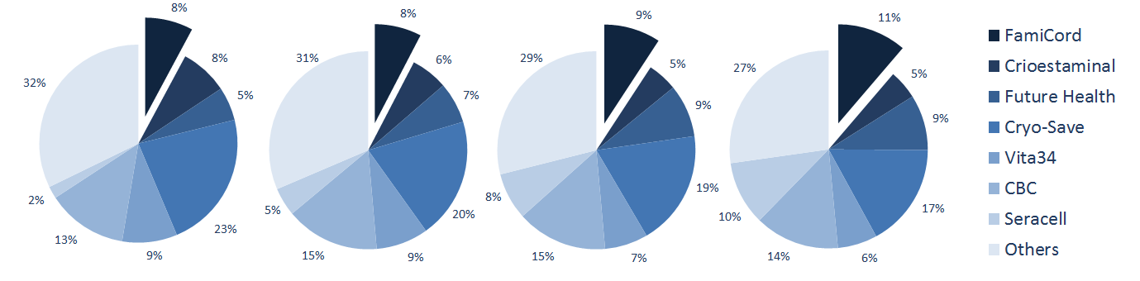
Market competitiveness
Cord blood European market share in 2009-2012
2009 2010 2011 2012
Growing market share of FamiCord from 8% in 2009 to 11% in 2012 (37% growth)
Significant but decreasing market share hold by small players (27% of market share in 2012)
The market will be consolidated by stronger players

Slide 11

Investment from financial partner
Enterprise Investors (EI)
Benefits to the Company
Since 2009 FamiCord has been controled by Enterprise Investors (EI), the oldest and one of the largest firms managing private equity and venture capital funds in Poland and CEE
Enterprise Venture Fund I (EVF), the venture capital fund managed by EI invested PLN 18.1 million (approx. € 4.4. mln) in combination of capital increase and purchase of shares
The investment aimed to finance the Company’s expansion, including acquisitions in Europe, as well as promotion of the fully ethical practice of stem cell storage and usage
The partnership with EI has strengthened the Company’s credibility and the foundation for long-term growth
EI investment approach
EI’s objective is to invest the money in companies that demonstrate high growth potential, and then to work with the entrepreneurs and the managers to increase the value of those companies
Since 1990 EI has raised 8 funds with combined capital of €2 billion and invested €1.5 billion in close to 130 companies, exited more than 90 investments with gross proceeds of €1.7 billion

